Slide 1
Artificial Intelligence, Data Science, and Global Pandemics
Kush R. Varshney krvarshn@us.ibm.com or krv5@cornell.edu http://krvarshney.github.io

Slide 2
Global Pandemics
COVID-19 is our focus now, but we should also prepare for the next one
What role do artificial intelligence and data science have to play in global pandemic mitigation and management?
Surveilling
Testing
Managing
Curing

Slide 3
Surveilling
Zoonotic pathogen prediction
There are a large number of known pathogens, but for most of them, it is not known whether they can transfer from animals into humans (and develop into outbreaks). It may be possible to predict the likely candidates with machine learning by training on features of known zoonotic pathogens.
Informed spillover surveillance
Once a pathogen is known as a zoonotic disease and has had an outbreak, it is important to monitor it for future outbreaks or spillovers. Reservoir species harbor pathogens without having symptoms and without dying, waiting for a vector to carry the disease to humans and start another outbreak. They can be predicted using machine learning.
Early warning
The earlier we know that an outbreak is starting, the earlier actions can be taken to contain it. There are often small signals in various reports and other data that indicate a disaster is beginning. Artificial intelligence helps us make sense of these weak signals.

Slide 4
Testing
Group testing
Making due with fewer tests by smartly pooling together inputs.
Deep learning from CT images
Deep neural networks have achieved better accuracy than expert physicians in several medical imaging tasks in radiology, dermatology, ophthalmology, and pathology.
Analyze chest CT images to diagnose COVID-19.
Even if this task is well done, will it find its way into clinical practice? That has not yet been the case in those tasks mentioned above despite the initial demonstrations having happened several years ago.
Classifying breathing patterns
Diagnosing COVID-19 based on the audio signal of your breathing and coughing

Slide 5
Managing
Spatiotemporal epidemiological modeling
Once an outbreak has started, it is important to model its spread to inform decision making in the response. This is the purview of epidemiology and has a lot of nuance to it. Small differences in the input can yield large differences in the output.
Data-driven decision making
Collecting primary (e.g. case counts), secondary (e.g. hospital beds, personal protective equipment), and tertiary (e.g. transportation and other infrastructure) information and using it to inform strategic decisions.
Engaging the public
In managing outbreaks, it is critical to inform the public of best practices to limit the person-to-person spread of the disease (which may go against cultural norms) and also to receive information from the situation on the ground, including contact tracing.

Slide 6
Curing
Drug repurposing
Drugs developed for particular diseases also have therapeutic effect on other diseases. By finding old generic drugs whose safety has already been tested and which might be inexpensive and already in large supply, we can quickly start tamping down an outbreak after the therapeutic effect is confirmed in a large-scale clinical trial. But such findings of repurposing are difficult to notice at large scale without the use of natural language processing of scientific publications.
Novel drug generation and discovery
Repurposing has its limits; we must also discover completely new drugs for new diseases. Generative machine learning modeling approaches accelerate the process.
Socioeconomic recovery
There has been a great economic burden of COVID-19 lockdowns, especially on the most vulnerable populations. Tools and techniques for guiding their recovery, including ones using AI are critical.

Slide 7
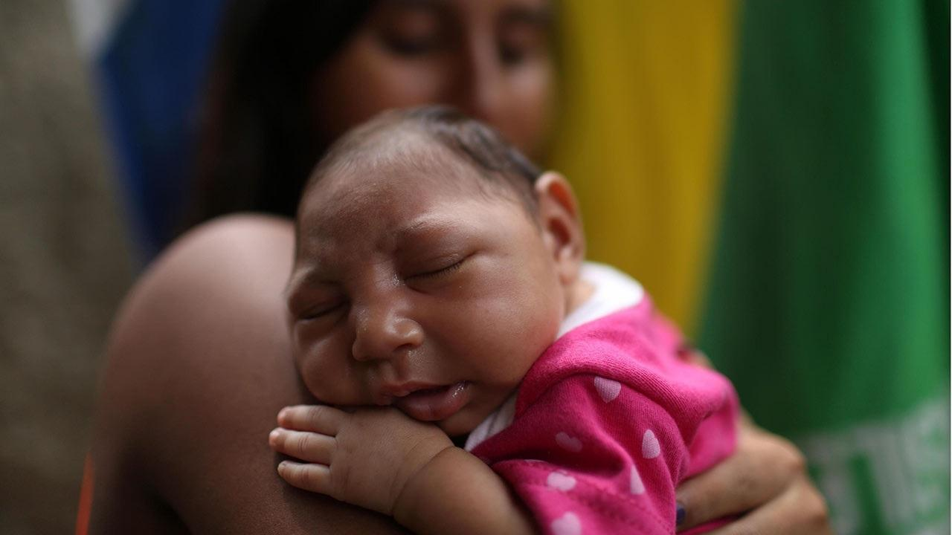
Informed spillover surveillance
B. A. Han, S. Majumdar, F. P. Calmon, B. S. Glicksberg, R. Horesh, A. Kumar, A. Perer, E. B. von Marschall, D. Wei, A. Mojsilović, and K. R. Varshney, “Confronting Data Sparsity to Identify Potential Sources of Zika Virus Spillover Infection Among Primates,” Epidemics, vol. 27, p. 59–65, June 2019.

Slide 8
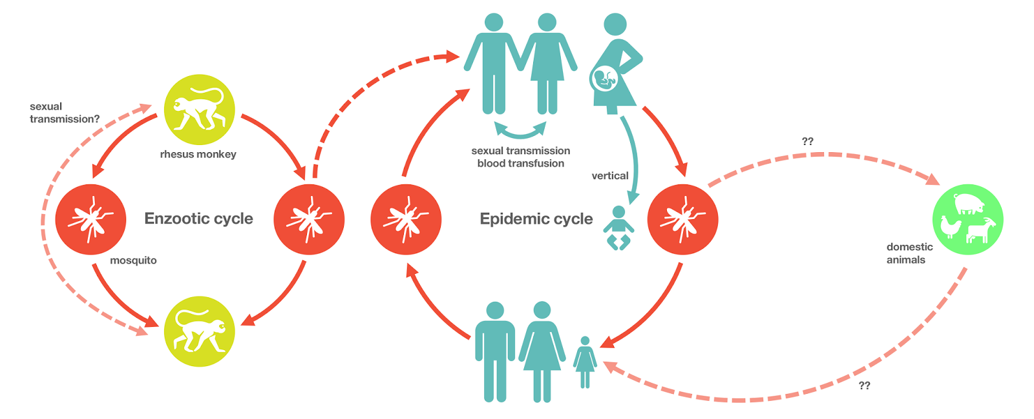
Zika Virus Transmission

Slide 9
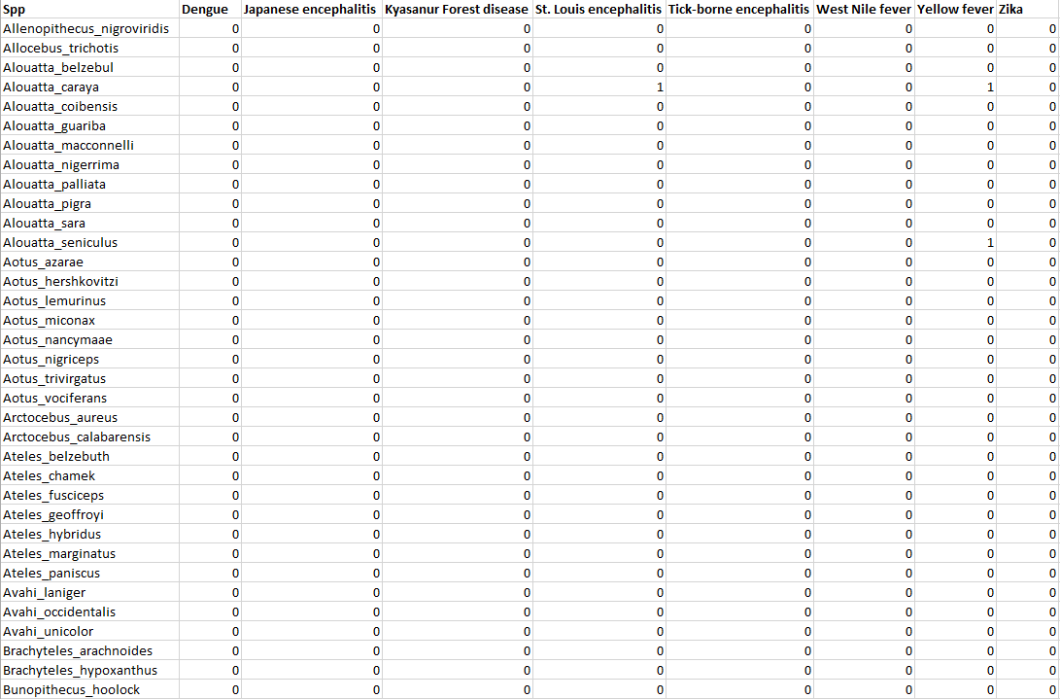
Known Primate Reservoirs of Flaviviruses in Africa

Slide 10
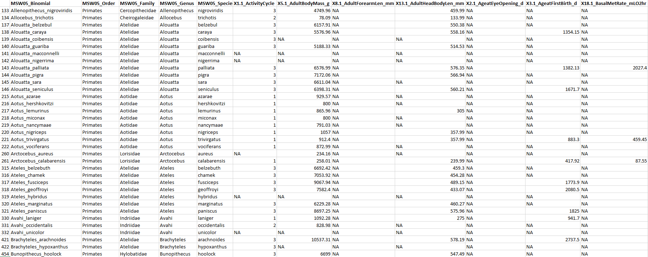
Primate Features

Slide 11



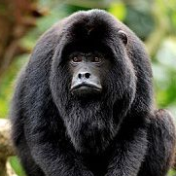
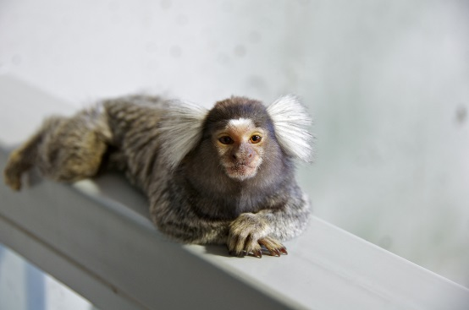

Likely Reservoirs
Species | Zika reservoir probability | Percentile risk | Status
Cebus apella | 0.55 | 98.6 | YFV+
Cebus albifrons | 0.36 | 95.1 | Undetected
Alouatta seniculus | 0.34 | 94.0 | YFV+
Alouatta caraya | 0.33 | 93.4 | YFV+, SLEV+
Callithrix jacchus | 0.29 | 91.5 | Undetected
Cebus capucinus | 0.28 | 91.0 | Undetected
Notes:
St. Louis Encephalitis Virus

Slide 12
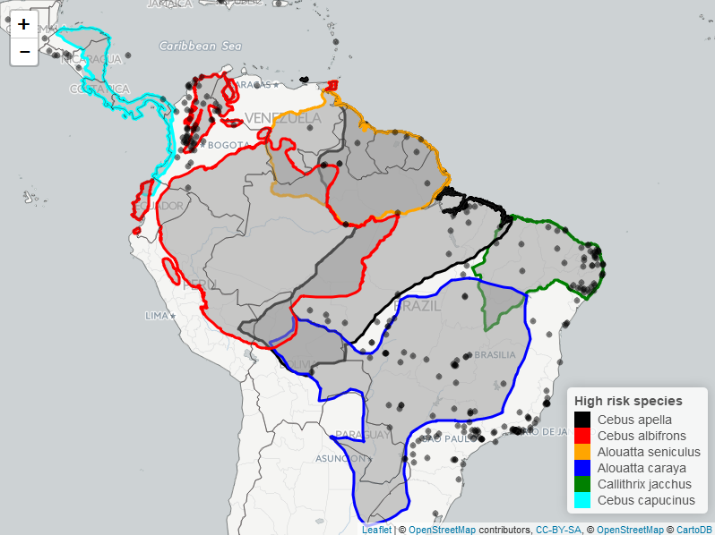
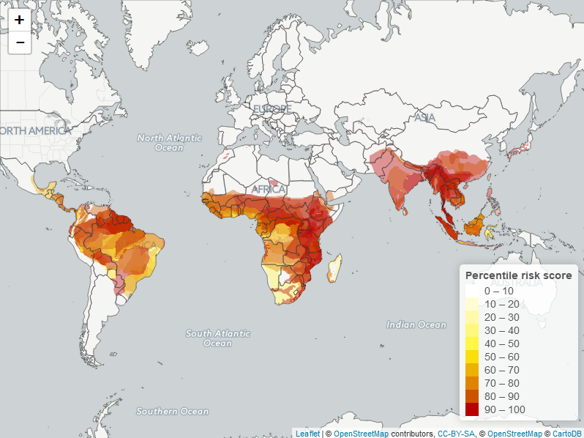
Ranges of Likely Reservoirs

Slide 13
Likely Reservoirs
Species | Zika reservoir probability | Percentile risk | Status
Cebus apella | 0.55 | 98.6 | YFV+
Cebus albifrons | 0.36 | 95.1 | Undetected
Alouatta seniculus | 0.34 | 94.0 | YFV+
Alouatta caraya | 0.33 | 93.4 | YFV+, SLEV+
Callithrix jacchus | 0.29 | 91.5 | ZIKV+
Cebus capucinus | 0.28 | 91.0 | Undetected
Favoretto et al. (2016), “First detection of Zika virus in neotropical primates in Brazil: a possible new reservoir”
Cebus libidinosus: lots of missing data
Notes:
St. Louis Encephalitis Virus

Slide 14

Drug repurposing
S. Subramanian, I. Baldini, S. Ravichandran, D. A. Katz-Rogozhnikov, K. N. Ramamurthy, P. Sattigeri, K. R. Varshney, A. Wang, P. Mangalath, and L. B. Kleiman. “A Natural Language Processing System for Extracting Evidence of Drug Repurposing from Scientific Publications.” Conf. Innov. Appl. Artif. Intell., Feb. 2020.

Slide 15


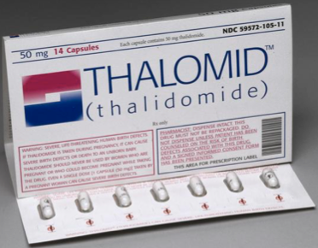
Generics Have Been Successfully Repurposed for Cancer
Tuberculosis (1928)
Acne (1962)
Morning sickness (1957)
Acute promyelocytic leukemia (1995)
Bladder cancer (1977)
Multiple myeloma (2006)
Notes:
St. Louis Encephalitis Virus

Slide 16



Scaling the Repurposing of Generic Drugs for Cancer
PREDICT
PROVE
USE
Evidence synthesis
Prediction of promising
treatments
Clinical validation
Proof of effective
treatments
Standard of care
Collaboration with
stakeholders
Notes:
St. Louis Encephalitis Virus

Slide 17
Information Sources
Thousands of scientific articles discuss results of non-cancer generic drugs being tested as cancer treatments
Clinical trials
Randomized controlled trials (RCTs) are the gold standard
1
Observational studies
Prospective and retrospective observational studies, and case reports
2
Pre-clinical studies
In vivo animal models and in vitro studies with cell lines; often evaluating mechanism of action
3
Conference reports, patents
Includes regulatory, policy, and legal records
4
Other sources
Includes news articles and science magazine reports
5
Notes:
St. Louis Encephalitis Virus

Slide 18
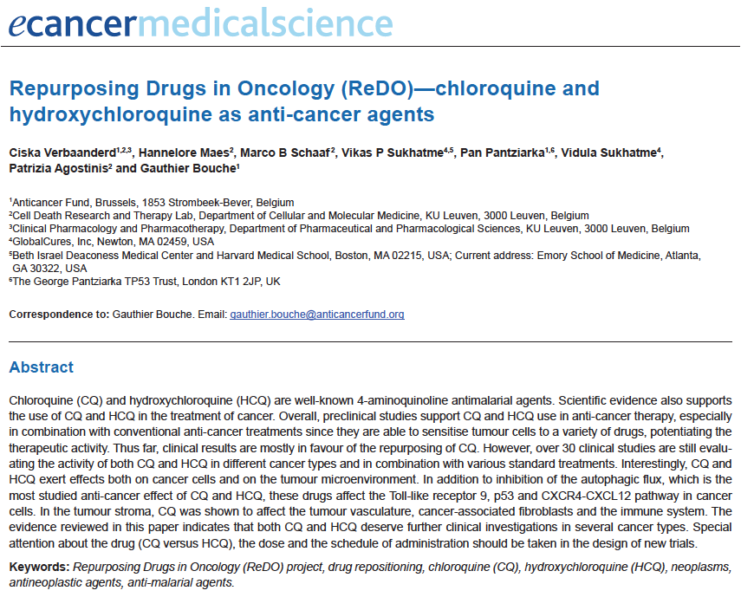
Manually Identifying Evidence is Intractable
Instead, use AI to identify, synthesize and prioritize evidence at scale
709 studies on hydroxychloroquine (HCQ) and cancer
264 studies with efficacy data on HCQ for cancer
1 review article summarizing evidence
Not feasible to integrate evidence from new findings
Study 1
Clinical trial
Study 2
In vitro study
Study 1
Effective
Study 2
Inconclusive
+ 150 studies
Study 3
In vivo study
Study 3
Detrimental
New
Study 264
No effect
Study 709
Observational study
Verbaanderd eCancer 2017
2.5 months
3.5 months
6 months
2017
Evidence
identification
Evidence extraction
Evidence synthesis
Dynamic corpus
New articles daily
Notes:
St. Louis Encephalitis Virus

Slide 19
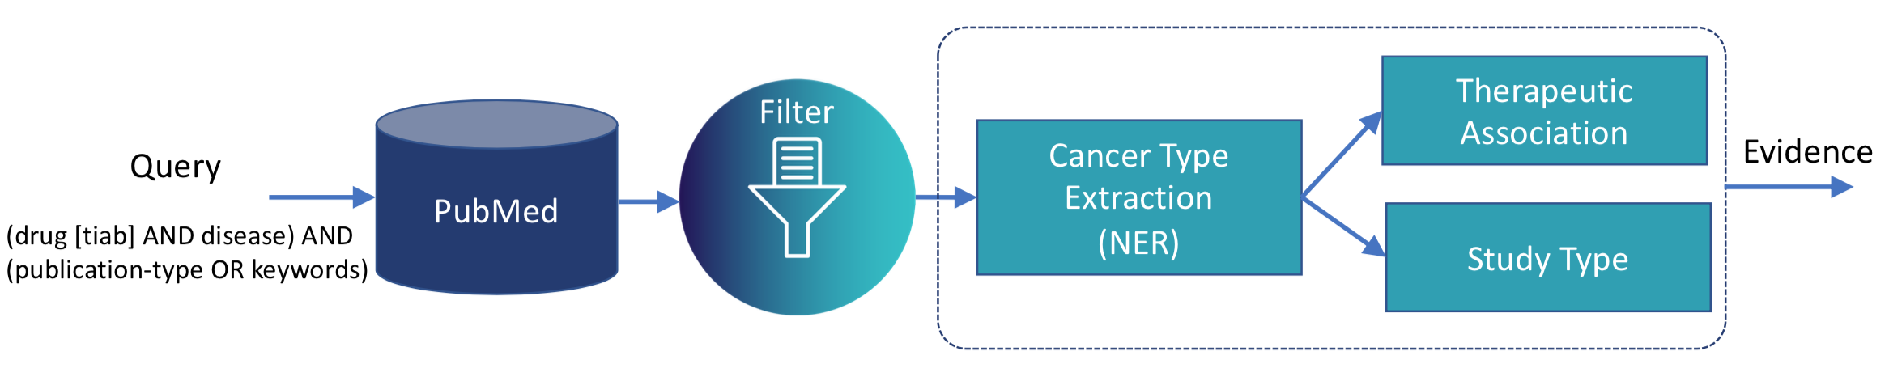
NLP Pipeline for Extracting Evidence from Scientific Publications
Notes:
St. Louis Encephalitis Virus

Slide 20
Example
Notes:
St. Louis Encephalitis Virus

Slide 21
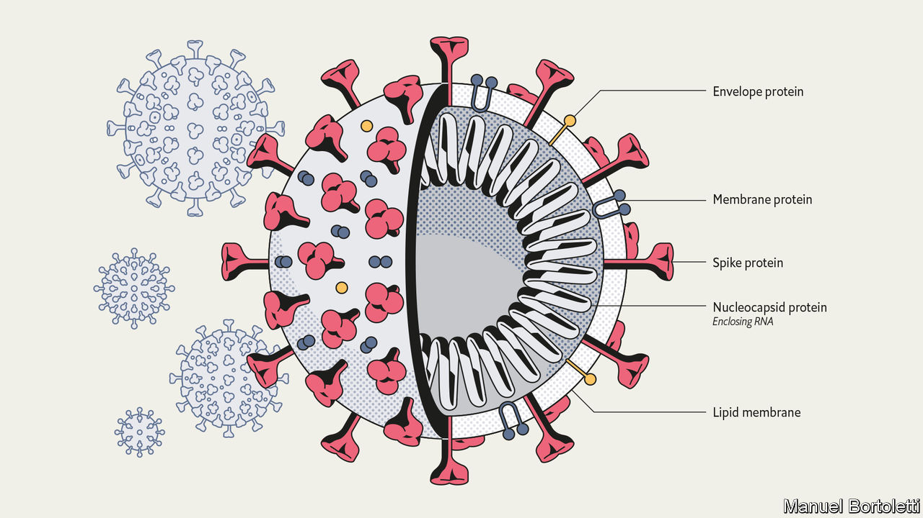
Novel drug generation and discovery
V. Chenthamarakshan, P. Das, I. Padhi, H. Strobelt, K. W. Lim, B. Hoover, and A. Mojsilović. “Target-Specific Drug Design for COVID-19 Using Deep Generative Models.” arXiv:2004.01215, Apr. 2020.

Slide 22
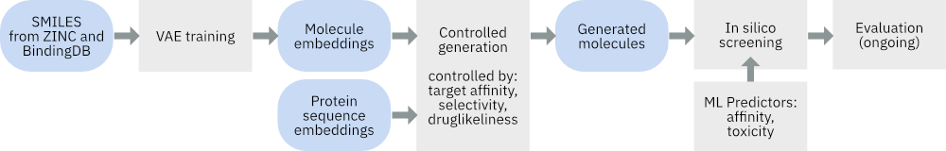
Drug Design Pipeline

Slide 23
COVID-19 Molecule Explorer
https://covid19-mol.mybluemix.net/

Slide 24
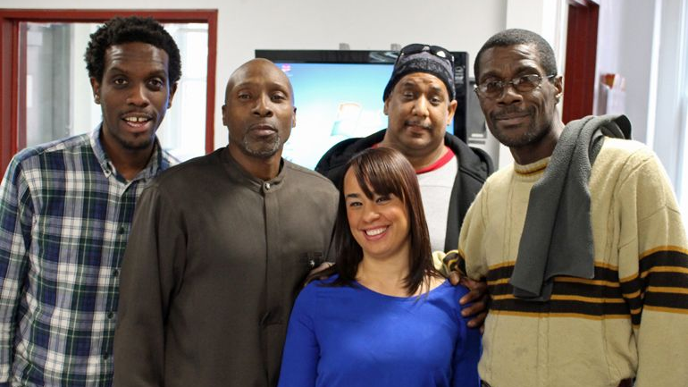
Socioeconomic recovery
W. Zhang, R. Horesh, K. N. Ramamurthy, L. Wu, J. Yi, K. Anderson, and K. R. Varshney, “Financial Forecasting and Recommendation for Low-Wage Workers,” Data for Good Exchange Conf., Sep. 2018.

Slide 25
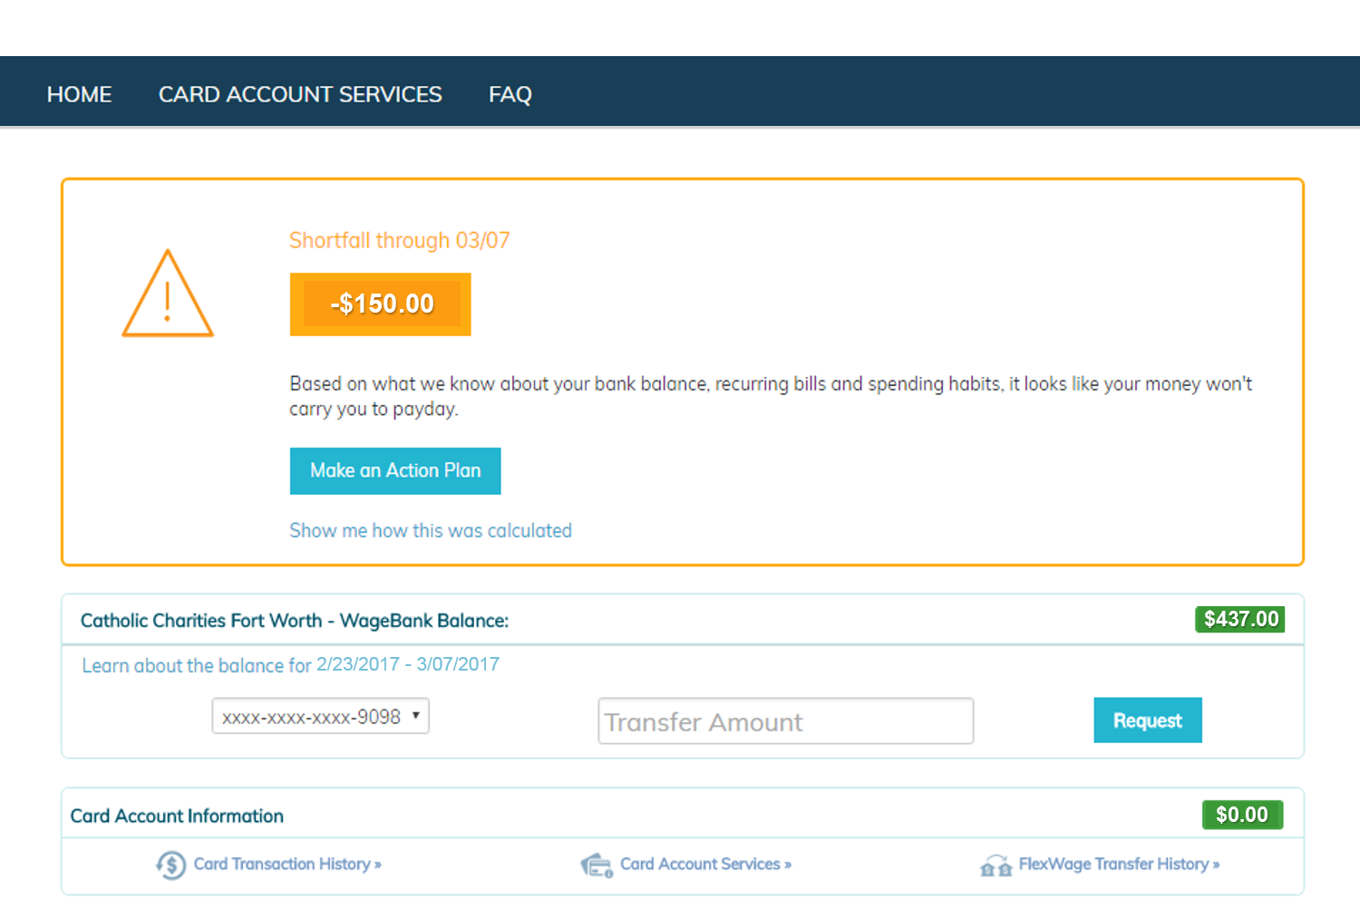
WageGoal

Slide 26
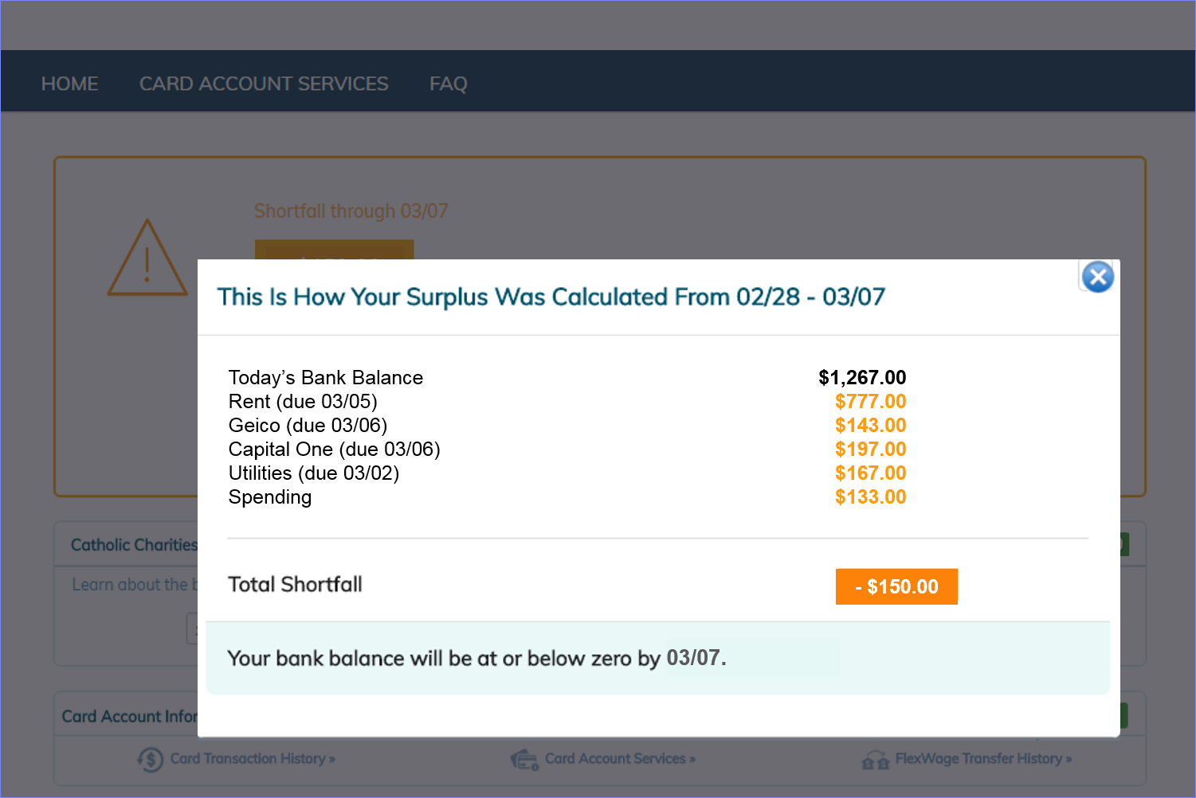
WageGoal

Slide 27
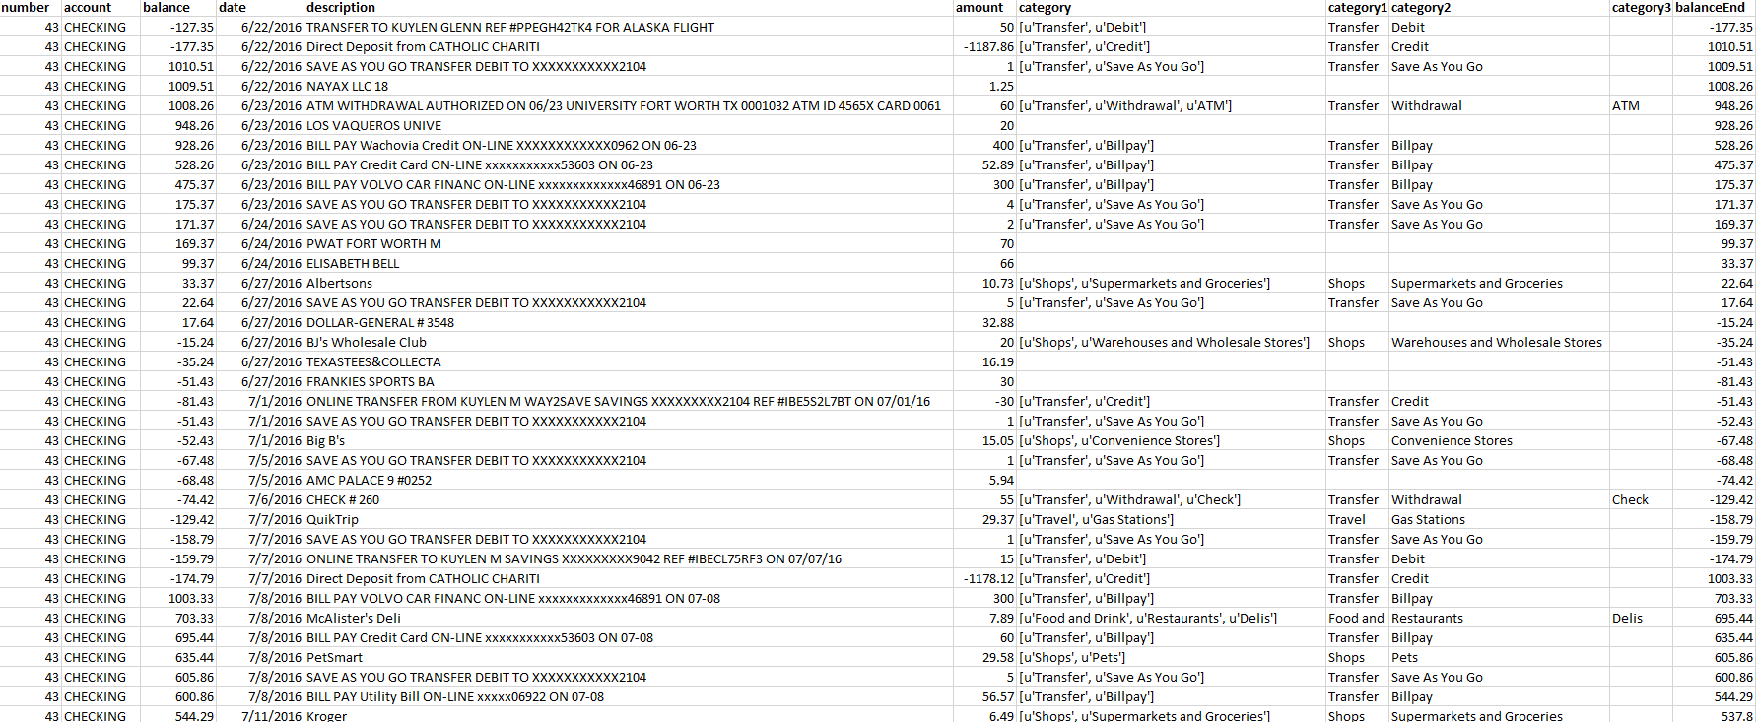
Transactions Data

Slide 28
Predictive Modeling
Method | MAE | Error in Days | Error in Amount
HistAvg | 11.4 | 3.0 | 7.5
Prophet | 9.5 | 4.5 | 7.5
BestMatch | 19.1 | 4.0 | 11.9
SubseqLS | 7.0 | 4.0 | 5.8
HistAvg + SuseqLS | 6.8 | 3.3 | 5.1

Slide 29

Responsibility and trust
K. R. Varshney, “Trustworthy Machine Learning and Artificial Intelligence.” ACM XRDS Mag., vol. 25, no. 3, p. 26-29, Spring 2019.

Slide 30







Trustworthy AI Takes Many Forms
causality
fair
AI for social good
robust
explainable
accountable
human-centered AI
mastering individual characteristics of trust
making sense of the world like humans do
creating ai that serves humanity

Slide 31
Delivering AI for good at scale
K. R. Varshney and A. Mojsilović, “Open Platforms for Artificial Intelligence for Social Good: Common Patterns as a Pathway to True Impact. ICML Workshop on AI for Social Good, 2019.

Slide 32









Why Haven’t We Seen the Impact Yet?
Pilot & Innovate
Social good applications often call for significant scientific advances in foundational AI.
Underlying innovation is costly and require hard-to-find skills that exists in only few places (e.g. IBM, Microsoft, Universities).
Harden & Reuse
Hardening and packaging AI applications require significant subject matter expertise and costly engineering effort.
Firms and organizations that could provide such services are not incentivized to work in sustainable development.
Deliver at Scale
Current engagement models are one-off and do not scale.
A platform for a delivery of AI for Good services at scale does not exist.

Slide 33
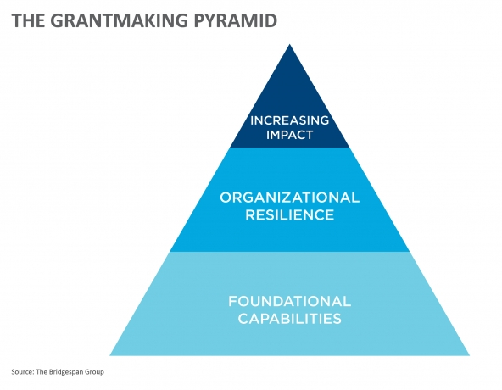

Reimagining Institutions: Grantmaking Foundations
Grantmakers are starting to understand that they cannot support only programmatic efforts of nonprofits, they must also support foundational capabilities to enable sustained impact.
Even if grantmakers want to support new solutions and foundational technologies, nonprofits are not in position to create these solutions themselves. Technology solution creators must also be involved.
The same technological platform can serve as a foundational capability to support not just one, but many nonprofits with similar missions.
Technology
Solution
Creators
Technology
Solution
Creators
grantmakers
grantmakers
grantmakers
“Time to Reboot Grantmaking,” Michael Etzel and Hilary Pennington
Stanford Social Innovation Review https://ssir.org/articles/entry/time_to_reboot_grantmaking

Slide 34
Reimagining Institutions: Government
Post World War II
United Nations
National Laboratories
National Science Foundation
Now
Science Readiness Reserves
National Science and Technology Foundation
New collaborative modes of conducting science

